Slide 1
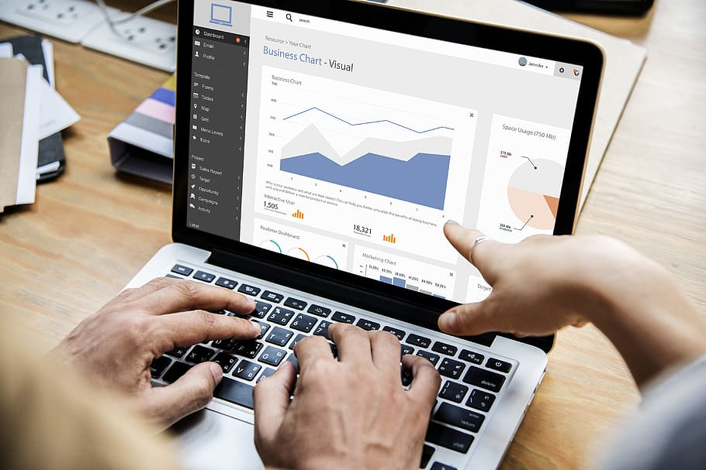
Introduction
In this project I used CRISP-DM approach for visualization of sales data where I have perform ETL process which stands for extract transform and load it is a general process which allows businesses to gather data from multiple sources and consolidate it into a single, centralized location.
Along with that I have used Data Analysis Expressions (DAX) functions for analysis as well as used dynamic filtering and data modelling for good interactions of table which help me to create great insights.
After that made key performance indicator (KPI), forecasting and publish it.
I used Power BI

Slide 2
Software And Hardware
Software :-
Google Chrome
Excel
MS Power BI Desktop
https://app.diagrams.net/ for schema designing
MS Power BI service
Hardware :-
Processor - Intel(R) Core(TM) i7-9750H CPU @ 2.60GHz 2.59 GHz
Installed RAM – 8.00 GB
NVIDIA GeForce GTX 1650 (4GB)

Slide 3
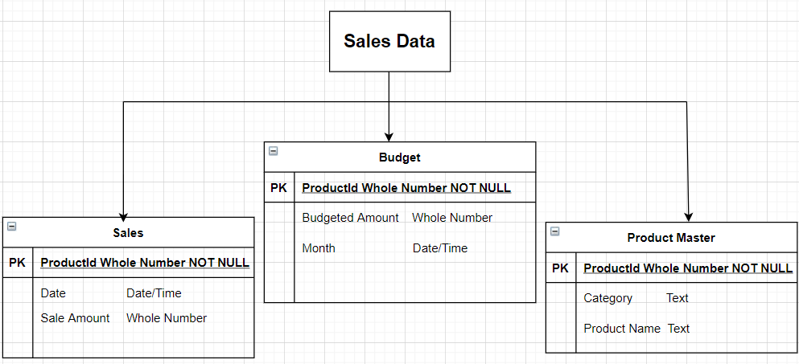
Database
Database used is Sales Data which include following table

Slide 4
Dataset
Budget
Sales
Product Master

Slide 5
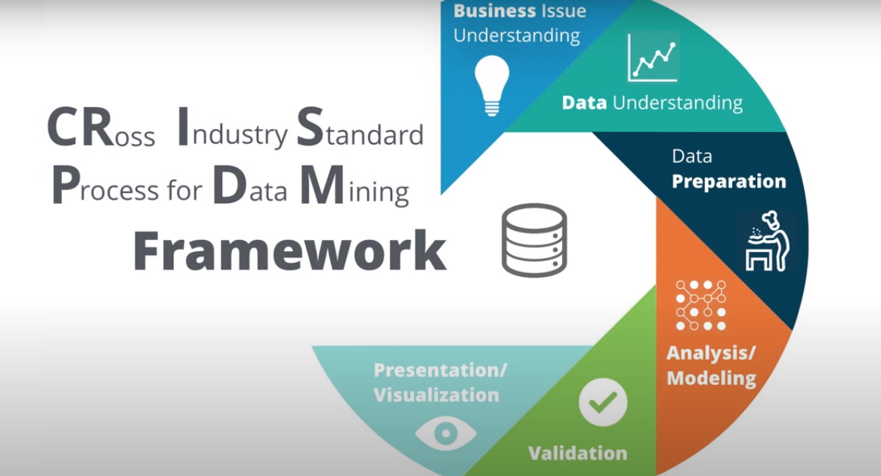
EXPLAINATION
I have used CRISP-DM as a methodology, it includes descriptions of the typical phases of a project, the tasks involved with each phase, and an explanation of the relationships between these tasks.
Business understanding – What does the business need?
First of all I targeted sales and go in depth that what type business is, define the business framework and problems, defining business objective by which we can work on that weakness part and improve it for profit maximization

Slide 6
Data Understanding and Preparation
Basically data understanding and preparation comprises of what data do we have / need? Is it clean? And How do we organize the data for modeling?.
For starters, we must know the variables in the data. A variable consists of two parts – the label and the data type. Every thing was fine there is not much changes needed some problems like headers and data type are automatically done by Power Pivot.
Data was clean, there is not any completeness, consistency & relevancy issues.
For example – there is no missing values, unwanted outliers, structural errors like N/A etc.
So, after checking all these, now we have to check, total numbers of data, data volume etc. in table.
Table budget contains “3 columns and 1155 rows” in Table sales contains “3 columns and 34090 rows” and table product master contains “3 columns and 15 rows”.

Slide 7
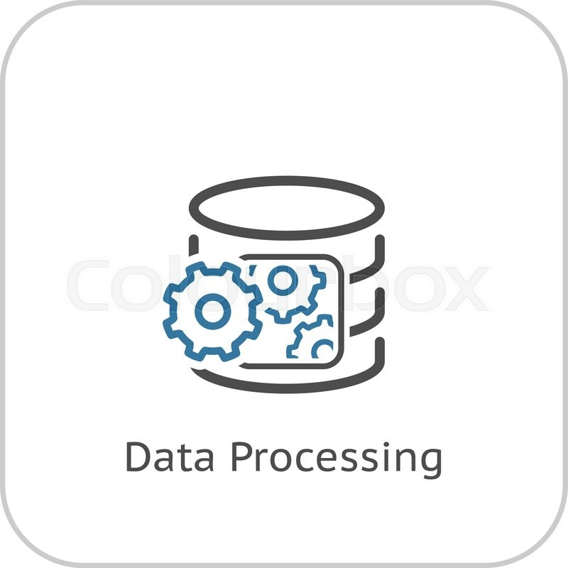
EXPLAINATION Cont..
Next, we have three table sales, Product Master, Budget now we will work on data preparation in which I have used different statistical approaches to check the data quality and data assessment.
First, I take out mean, median and mode after that standard deviation to check spread of data.
Second, I worked on quartile and inter quartile range(IQR) to check the quality and for outliers after than lower and upper values for the exact numbers.
Third I checked all those with cards and charts.
I found everything is fine and now we are ready for the next steps.

Slide 8
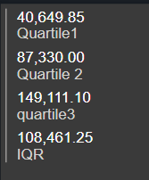
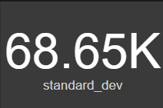
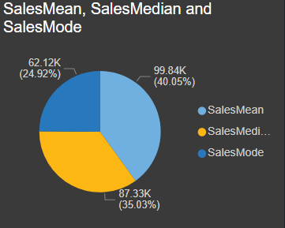
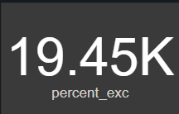

DATA PREPARATION GRAPHICALLY AND STATICALLY BY DAX FUNCTIONS
Spread of data from mean
Statically quartile value
Graphically presentation
10% of Data value
Sales mean mode median

Slide 9
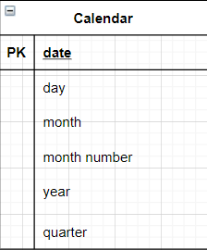
ADDED NEW TABLE CALENDAR
Now after all these we are ready for modeling but what I observed that we have not any date dimension available in table.
If we don’t have date dimension so we will face problem in creating goal oriented visualization, so we need it.

Slide 10
DAX FUNCTIONS USED FOR PREPARATION AND VISUALIZATION
Budget Variance% = DIVIDE([CY Sales]-[SalesBudget],[SalesBudget],BLANK())
CY Sales = Var CY = MAX('Calendar'[year] ) Return CALCULATE([TotalSales],'Calendar'[year] = CY)
Quartile1 = PERCENTILE.INC(Sales[Sale Amount],0.25)
Quartile 2 = PERCENTILE.INC(Sales[Sale Amount],0.50)
quartile3 = PERCENTILE.INC(Sales[Sale Amount], 0.75)
IQR = [quartile3]-[Quartile1]
standard_devx = STDEVX.P(Sales,Sales[CY Sales]-[PY Sales])
standard_dev = STDEV.P(Sales[Sale Amount])
lowerLimit = [Quartile1]-1.5*[IQR]
percent_exc = PERCENTILE.EXC(Sales[Sale Amount],0.10)
PY Sales = CALCULATE([CY Sales],SAMEPERIODLASTYEAR('Calendar'[Date]))
SalesMean = AVERAGE(Sales[Sale Amount])
SalesMedian = MEDIAN(Sales[Sale Amount])

Slide 11
DAX FUNCTIONS CONT…
SalesMode =
MINX(
TOPN(
1,
ADDCOLUMNS(
VALUES(Sales[Sale Amount]),
"Frequency", CALCULATE(COUNT(Sales[Sale Amount]))
),
[Frequency],
0
),
Sales[Sale Amount]
)
TotalSales = SUM(Sales[Sale Amount])
UpperLimit = [quartile3]+1.5*[IQR]
YOY Sales Growth% = DIVIDE([CY Sales]-[PY Sales],[PY Sales],BLANK())

Slide 12
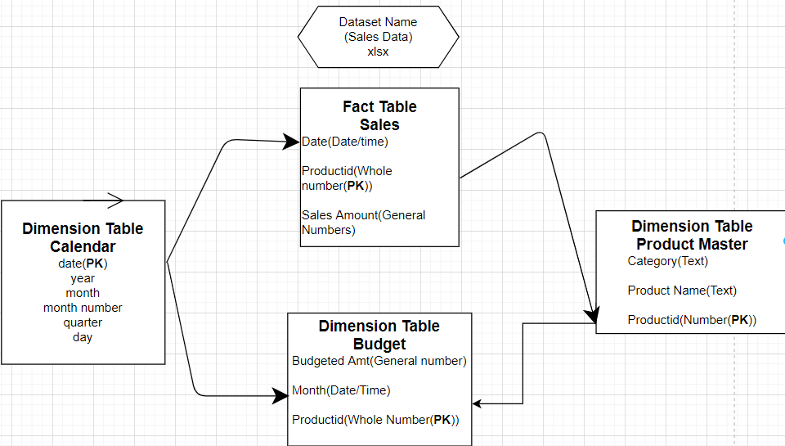
EXPLAINATION
Modeling – What modeling techniques should we apply?
I have seen One fact table and two dimension table and added table is also dimension table.
Evaluation – Which model best meets the business objectives?
I have seen model and build it properly and in cardinality i used many to one for connecting all the tables which is necessary for business objectives.
After this process I hided the productid, date which are repeating so that while building data model and dashboard no problems occurs.
After all this process I moved towards my Dashboard section and created some quick measures for KPI's like YoY sales, SalesBudget, TotalSales, CY sales, PY sales.

Slide 13
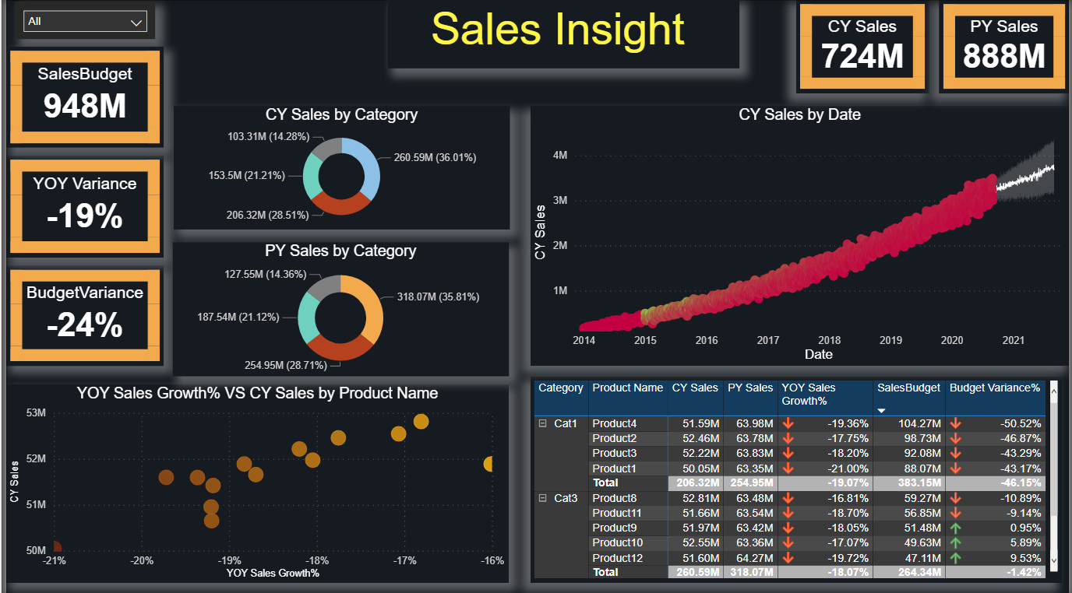
DEPLOYMENT(VISUALIZATION)

Slide 14
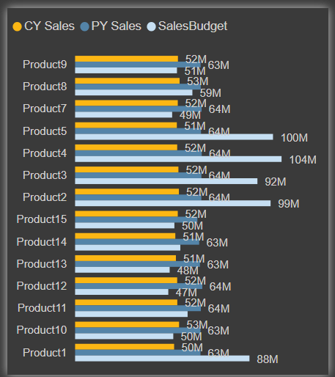
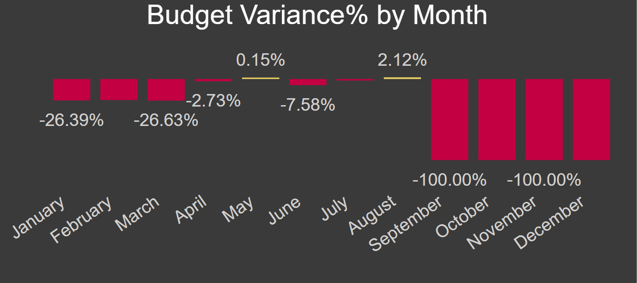
Tooltips

Slide 15
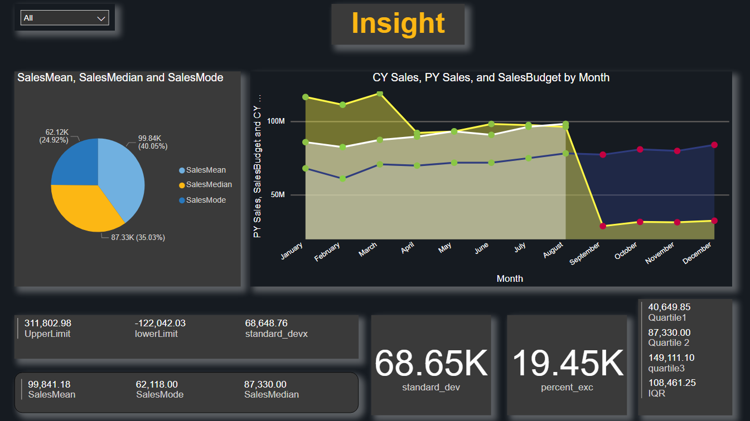
2nd Visualization statically and graphically

Slide 16


